Slide 1
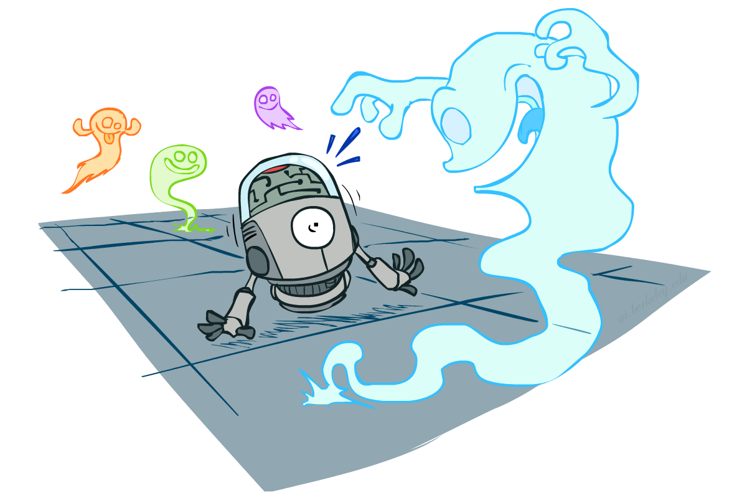
CS 188: Artificial Intelligence
Probability
Instructors: Dan Klein and Pieter Abbeel --- University of California, Berkeley
[These slides were created by Dan Klein and Pieter Abbeel for CS188 Intro to AI at UC Berkeley. All CS188 materials are available at http://ai.berkeley.edu.]
Notes:
Please retain proper attribution, including the reference to ai.berkeley.edu. Thanks!

Slide 2
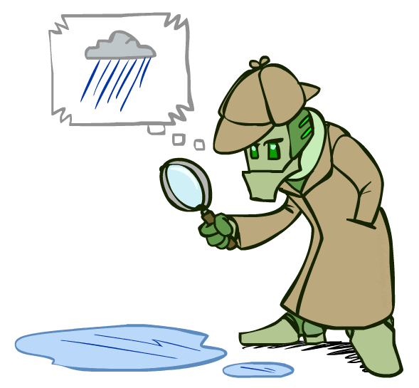
Probabilistic Inference
Probabilistic inference: compute a desired probability from other known probabilities (e.g. conditional from joint)
We generally compute conditional probabilities
P(on time | no reported accidents) = 0.90
These represent the agent’s beliefs given the evidence
Probabilities change with new evidence:
P(on time | no accidents, 5 a.m.) = 0.95
P(on time | no accidents, 5 a.m., raining) = 0.80
Observing new evidence causes beliefs to be updated

Slide 3





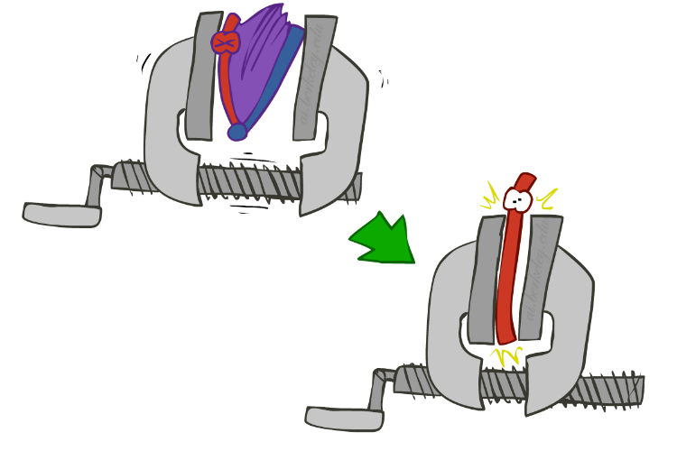
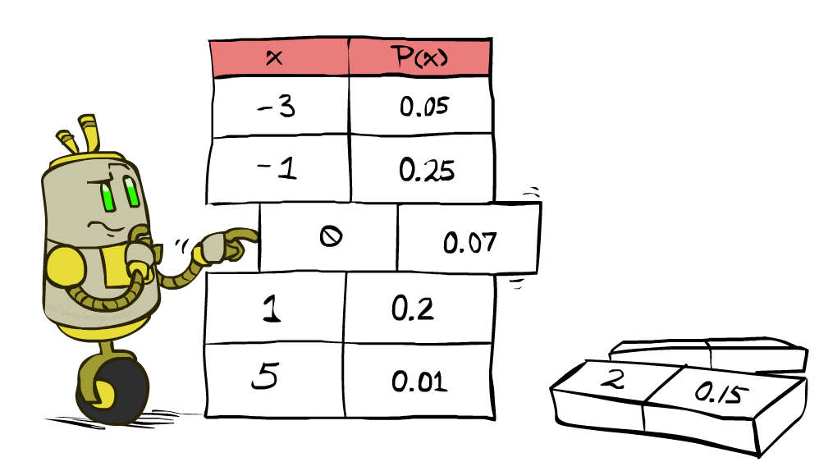


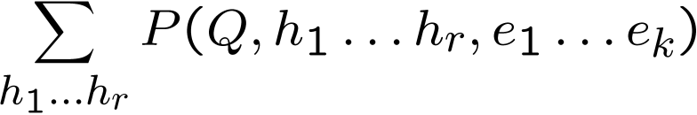
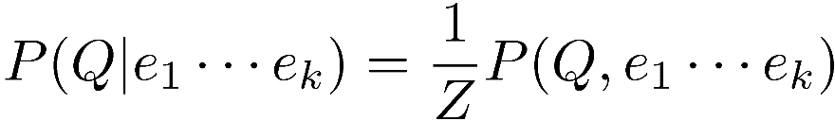
Inference by Enumeration
* Works fine with multiple query variables, too
General case:
Evidence variables:
Query* variable:
Hidden variables:
We want:
All variables
Step 1: Select the entries consistent with the evidence
Step 2: Sum out H to get joint of Query and evidence
Step 3: Normalize

Slide 4
Inference by Enumeration
P(W)?
P(W | winter)?
P(W | winter, hot)?
S | T | W | P
summer | hot | sun | 0.30
summer | hot | rain | 0.05
summer | cold | sun | 0.10
summer | cold | rain | 0.05
winter | hot | sun | 0.10
winter | hot | rain | 0.05
winter | cold | sun | 0.15
winter | cold | rain | 0.20

Slide 5
Inference by Enumeration
Obvious problems:
Worst-case time complexity O(d^{n})
Space complexity O(d^{n}) to store the joint distribution

Slide 6
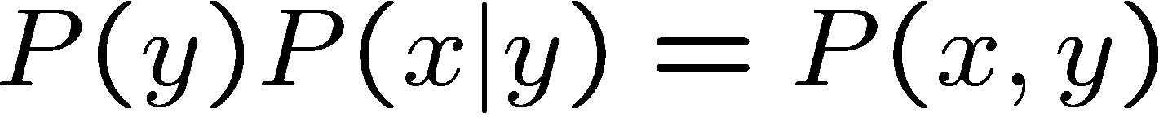
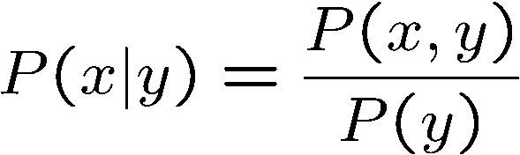
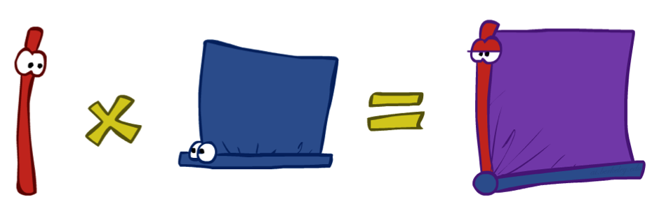
The Product Rule
Sometimes have conditional distributions but want the joint

Slide 7



The Product Rule
Example:
D | W | P
wet | sun | 0.1
dry | sun | 0.9
wet | rain | 0.7
dry | rain | 0.3
D | W | P
wet | sun | 0.08
dry | sun | 0.72
wet | rain | 0.14
dry | rain | 0.06
R | P
sun | 0.8
rain | 0.2

Slide 8
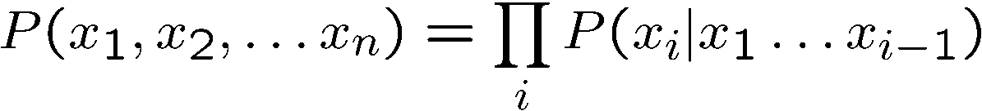
The Chain Rule
More generally, can always write any joint distribution as an incremental product of conditional distributions
Why is this always true?

Slide 9
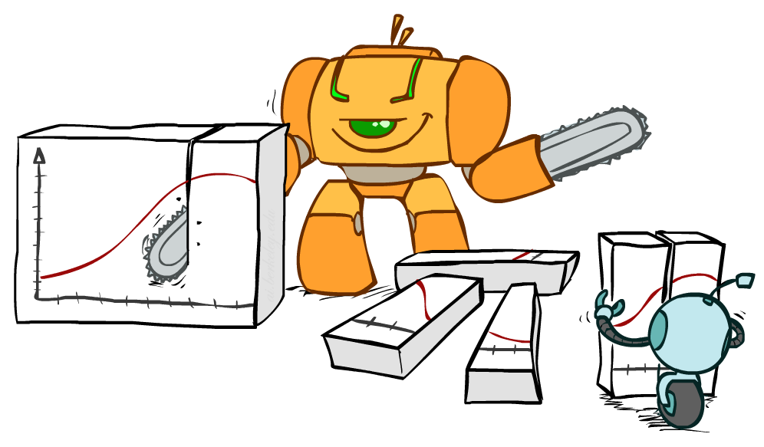
Bayes Rule

Slide 10


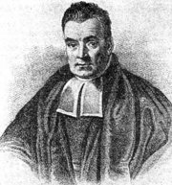
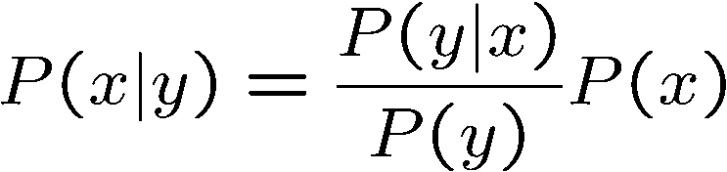
Bayes’ Rule
Two ways to factor a joint distribution over two variables:
Dividing, we get:
Why is this at all helpful?
Lets us build one conditional from its reverse
Often one conditional is tricky but the other one is simple
Foundation of many systems we’ll see later (e.g. ASR, MT)
In the running for most important AI equation!
That’s my rule!

Slide 11
Inference with Bayes’ Rule
Example: Diagnostic probability from causal probability:
Example:
M: meningitis, S: stiff neck
Note: posterior probability of meningitis still very small
Note: you should still get stiff necks checked out! Why?
Example
givens

Slide 12
Quiz: Bayes’ Rule
Given:
What is P(W | dry) ?
D | W | P
wet | sun | 0.1
dry | sun | 0.9
wet | rain | 0.7
dry | rain | 0.3
R | P
sun | 0.8
rain | 0.2

Slide 13
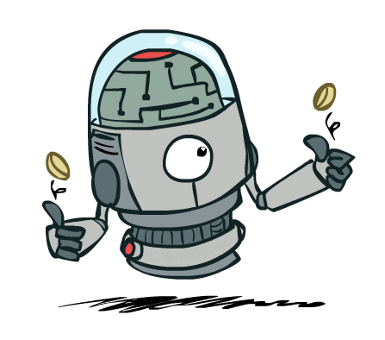
Independence

Slide 14

Independence
Two variables are independent if:
This says that their joint distribution factors into a product two simpler distributions
Another form:
We write:
Independence is a simplifying modeling assumption
Empirical joint distributions: at best “close” to independent
What could we assume for {Weather, Traffic, Cavity, Toothache}?

Slide 15
Example: Independence?
T | P
hot | 0.5
cold | 0.5
T | W | P
hot | sun | 0.4
hot | rain | 0.1
cold | sun | 0.2
cold | rain | 0.3
T | W | P
hot | sun | 0.3
hot | rain | 0.2
cold | sun | 0.3
cold | rain | 0.2
W | P
sun | 0.6
rain | 0.4

Slide 16


Example: Independence
N fair, independent coin flips:
H | 0.5
T | 0.5
H | 0.5
T | 0.5
H | 0.5
T | 0.5

